Slide 1
Disaster Capitalism
Unnatural Disasters
Seminar 18

Slide 2
Concept Work
Discuss and define the concept
Can the concept be applied to Hurricane Katrina? How?
Find one example, case or story from Markets of Sorrow that shows how the concept can be applied to Katrina.

Slide 3
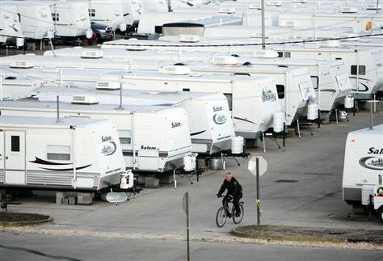
Disaster Capitalism

Slide 4
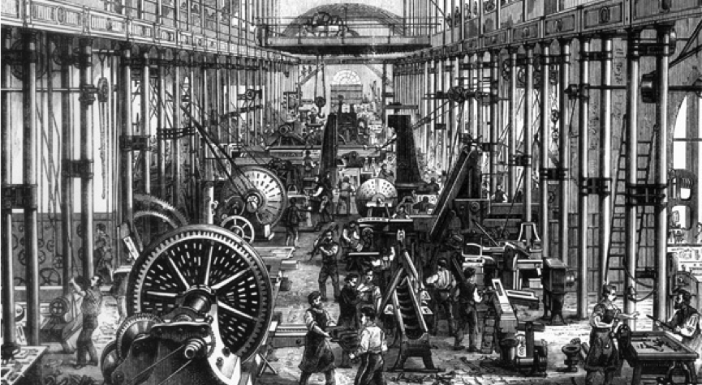
Capitalism

Slide 5
Smith
Marx
Weber
Notes:
Smith’s theory = wealth of nations derives from productivity, source of productivity is ‘desire to exchange’; exchange leads to increases in efficiency and benefit. However, for Smith this is a ‘social law’ and is not a consequence of modernity.
Marx= MCM1 = exploitation [difference of value produced by labour vs. price of labour purchased (wage)
Weber = capitalism is identical with the pursuit of profit, and forever renewed profit, by means of continuous, rational, enterprise.
Capitalism = ‘profit’ –a force for rationalization….greater and greater efficiency . . . .

Slide 6
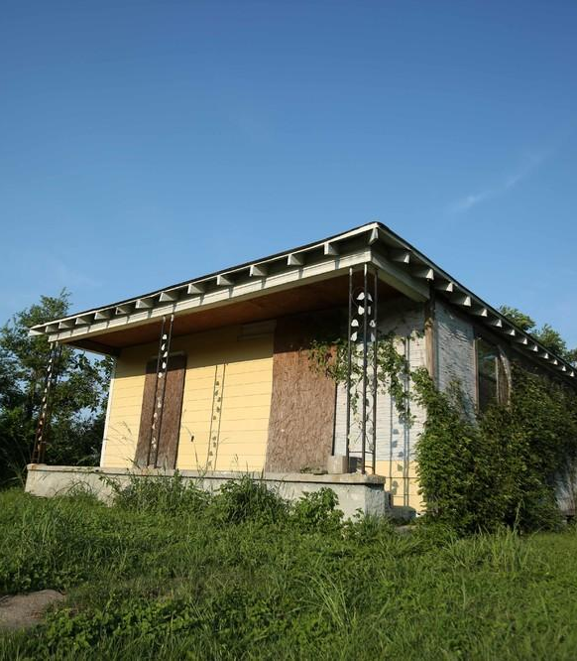
The Road Home
What are the “inefficiencies of profit”?

Slide 7
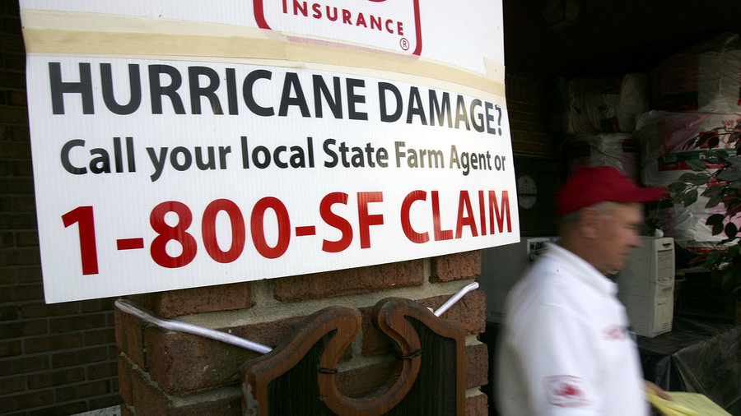
Failures of insurance

Slide 8
Was Hurricane Katrina an ‘insurable’ or ‘uninsurable’ risk?
Each table come to a decision, drawing on evidence from film or text.

Slide 9
Disaster capitalism and disaster nationalism
Compare

Slide 10
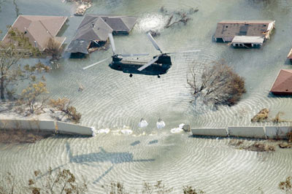
Katrina as a ‘manufactured risk’?

